Slide 1
Last time: Paradigms for anticipating regional climate change impacts
The WWDD hypothesis/paradigm
The Francis/Vavrus jet stream hypothesis
ENSO (empirical observations)

Slide 2
3. ENSO (introduced in Week 2)
Upwelling water
El Niño / La Niña shifts are referred to as ENSO (for El Niño / Southern Oscillation). Lots of work has shown that there are teleconnections (impacts in other places) of ENSO.

Slide 3
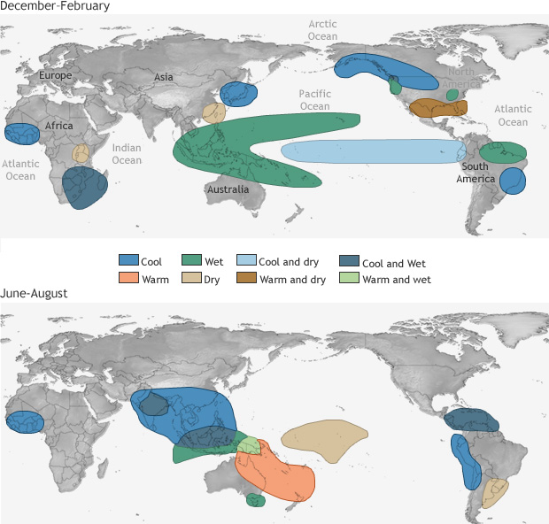
Teleconnections of La Niña
https://www.climate.gov/news-features/featured-images/global-impacts-el-ni%C3%B1o-and-la-ni%C3%B1a

Slide 4
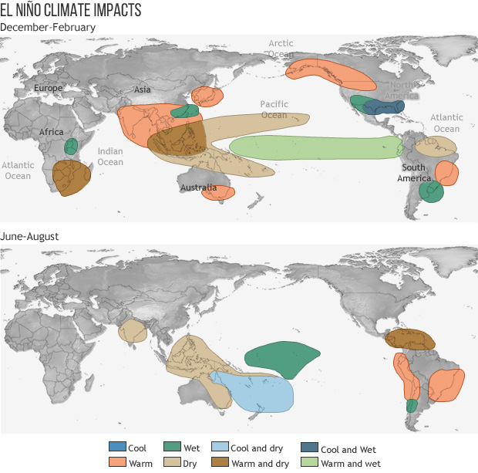
Teleconnections of El Niño

